Slide 1
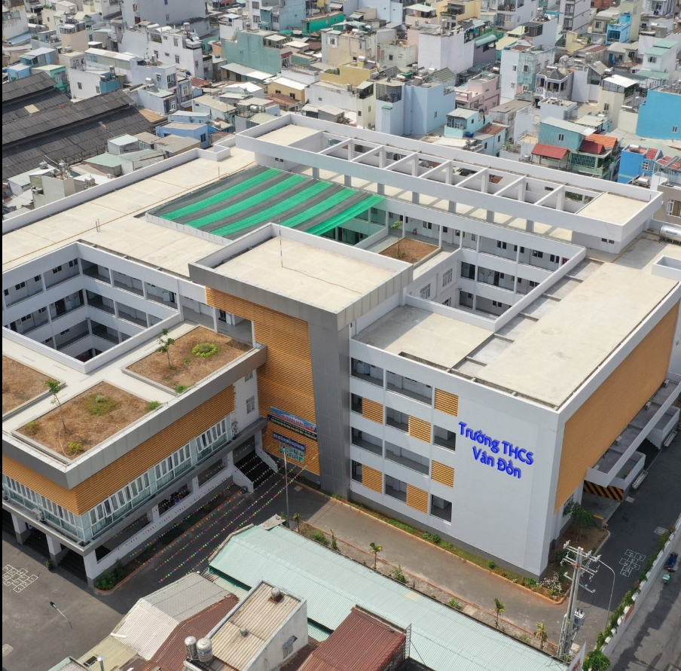
Van Don Secondary School

Slide 2
WRITE
Look at Hoa's letter to Tim. She wrote it at the end of term. Identify the sections. Label them with correct letter.
A - Body of the letter
B - Heading - writer’s address and the date
C - Closing - Your friend / Regards / Love
D - Opening - Dear

Slide 3
12 Tran Hung Dao St.
Ha Noi
February 10, 200…
Dear Tim,
Thanks for your letter. I’m pleased to hear you had an enjoyable Christmas vacation.
We received our first semester report a few days ago. I got good grades for Science, English and History, but my math result was poor. My Math teacher asked me to spend more time on it. I must study harder next semester.
It is almost Tet. That’s the Lunar New Year Festival in Viet Nam. I think I told you about it in my last letter. We’re going to Hue tonight to celebrate the festival with my grandmother. I’ll send you a postcard from there.
Write soon and tell me all your news.
Regards,
Hoa
B
D
A
C

Slide 4
Vocabulary
Behavior (n) : Hành vi, cử chỉ
→ behave (v)
Comment (n) : lời nhận xét
Co-operation (n): sự hợp tác
Habit (n) : thói quen
Mother tongue (n): tiếng mẹ đẻ
Participation (n): sự tham gia
→ participate (v)
Satisfactory (adj): thỏa mãn
→ satisfy (v), satisfaction (n)
Term (n) : học kì, thời hạn
Find out : tìm ra
Instead of : thay vì
Necessary (adj) : cần thiết

Slide 5
Grammar
1.Commands and request in reported speech
(câu mệnh lệnh, đề nghị)
Form:
Ex: She asked me to give you this dictionary
The teacher said to me, “Go to the board, please.”
The teacher told/asked me to go to the board.
S + asked / told + Object + (not) to + Vo

Slide 6
2. Advice in reported speech (lời khuyên)
Form :
S1 + said + (to S.O) (that) + S2 + should (not) + Vo
S1 + told + S.O (that) + S2 + should (not) + Vo
S1 + advised + O + (not) to + Vo
Ex:
The doctor said to Mr.Trung, “You shouldn’t drink alcohol.”
→The doctor advised Mr.Trung not to drink alcohol.

Slide 7
Thay đổi trong câu tường thuật:
Direct (trực tiếp) Indirect (gián tiếp)
now then
this / these that / those
here there
today that day
tomorrow the next day / the following day
yesterday the day before / the previous day
ago before
next Monday the next Monday

Slide 8
2. Now help Lan write a letter to her pen pal Donna in San Francisco. Use the information in the box.
Mother’s Day
second semester report / last month
good grades / Geography / Physics / Math
teacher / tell / improve English / History
in a few weeks / Mid-Autumn Festival / moon festival
Ha Long Bay / aunt and uncle / bus / this afternoon
send you / postcard

Slide 9
218 Nguyen Tat Thanh St.
Ho Chi Minh
November 11th , 2021
Dear Donna
Thanks for your letter. I’m happy to hear that you had a nice Mother’s Day. I received my second semester report last month. I got good grades for Geography, Physics and Math, but my history and English results were not good. My teacher told me that I should improve English and History. I am spending more time on them this summer. And I hope I’ll be better at the two subjects next year.
The Mid-Autumn Festival will come in a few weeks. That’s the Moon Festival in Viet Nam. I’m going to Ha Long Bay with my aunt and uncle by bus this afternoon. I’ll send you a postcard from there.
Write to me as soon as possible. I’m looking forward to hearing from you
Best regards,
Lan

Slide 10


Good bye, see you later !

